Slide 1

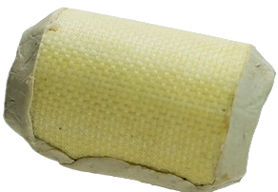



Classification and Retrieval System for Gas Pipe Repairs
CheckPoint #3
Team 1: Minal Jamshed, Prima Acharjee, Michele Panteleo

Slide 2








Outline
Recap
Data Preparation
Methodology
Evaluation
What’s next?

Slide 3

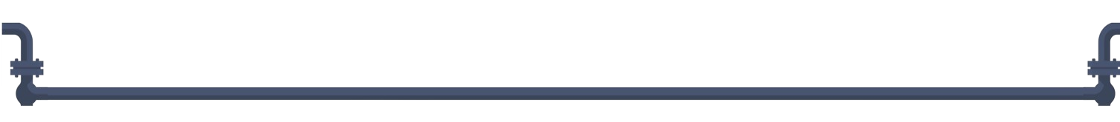
Problem Description
This project deals with gas leaks. Whenever a fault happens, gasfitters are asked to fix it by choosing the best strategy (welding, substituting, patching).
Gas leak
Notes:
Gasfitter is called and asked for stopping gas outflowing. It has many options, he can decide to weld broken pieces, substitute the pipe or 🡪

Slide 4





Mission
Our mission is to develop a chatbot to help gasfitters about patching or not, explaining why. Chatbot will answer based on fault description and past interventions.
Retrieve
Decide
Explain
Notes:
How would we make it reality?
Create a chatbot that
Exploits company experience
To decide whether to apply a patch or not
Providing an explanation of such decision
Workers will query this chatbot with pipe fault info, getting an answer in few seconds.

Slide 5








Value Proposition
Innovate
Reduce Gas Leaks Impact
Improve Safety
Notes:
BRINGING the Innov through AI- SDG 9 (Industry, Innovation, and Infrastructure):
Decision making tool to FOSTER smarter data driven solution
SUSTAINABILITY of infrastrusture on the gas industry.
REDUCING Env impact(Responsible Consumption and Production)
instd of going through an OVERALL replacement the proj
- is PROMOTING RESOURCE EFFICIENCY - REPAIR instd of REPLACeMENT
- MINIMIZING the waste of material.
- Lessening the chances of gas leaks which is helping in BETTER URBAN ENVIRONMENT. IMPROVING safety SDG 11 (Sustainable Cities and Communities)-
- Ensures safety for the workers,
- For the communities by addressing gas leaks for effectively

Slide 6
Data Preparation

Slide 7

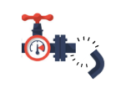
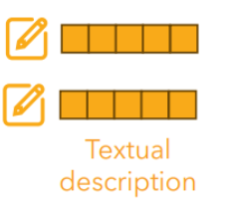
Data Collection
Spot
Analyse
Describe

Slide 8
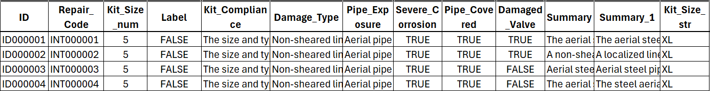
Data Collection
Collect and Organize in a CSV
Notes:
UP:
Profiles of users
- That help team understand- who will use the proj,
what they need -
how they will use it.
- Design a sol that fits real user's need.
- Keeping this in mind we have fitted in the Researchers (the ppl from polito and links who will evaluate the classification and retrieval algorithms),
gasfitters (primary users) and
CoRE( enhances official eff) .

Slide 9
Data Collection
Features considered
Notes:
UP:
Profiles of users
- That help team understand- who will use the proj,
what they need -
how they will use it.
- Design a sol that fits real user's need.
- Keeping this in mind we have fitted in the Researchers (the ppl from polito and links who will evaluate the classification and retrieval algorithms),
gasfitters (primary users) and
CoRE( enhances official eff) .

Slide 10

Two
Setup
Database
False: 5889 (99%)
True: 63 (1%)
Half-Half Split
Summaries
False: 11.778 (99%)
True: 126 (1%)
Test Set
False: 5889 (99%)
True: 63 (1%)
<
Database
False: 11.778
True: 126
Rephrased Split
Test Set
False: .11.778.
True: 126
Summaries and Rephrased
Notes:
This diagram illustrates our strategic approach to data segmentation, enabling tailored analysis and model training methodologies

Slide 11
Methodology

Slide 12
Generating Embeddings
The aerial steel pipe has a non-sheared linear…..
Steel aerial pipe suffers from a non-sheared l…..
Sample text

Slide 13

Generating Embeddings
The aerial steel pipe has a non-sheared linear…..
Steel aerial pipe suffers from a non-sheared l…..
Sample text
SentenceEncoder (SBERT / SRoBERTa)

Slide 14
Generating Embeddings
The aerial steel pipe has a non-sheared linear…..
Steel aerial pipe suffers from a non-sheared l…..
Sample text
SentenceEncoder (SBERT / SRoBERTa)
Converting to a fixed-size vector embedding

Slide 15
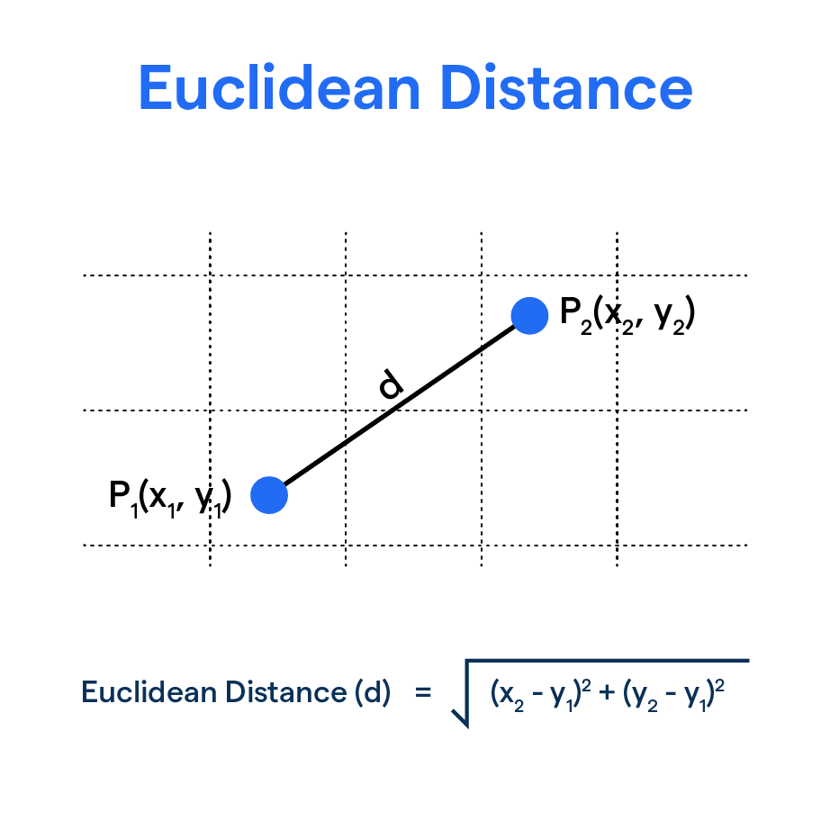




Similarity Checking-FAISS
Database
(Original Embeddings)
Distance
Test Query
(Unseen Embeddings)
Retrieves top_k similar ‘ID’s

Slide 16
Organizing Embeddings in DataFrames
ID | Embeddings | Successful
ID000064 | [-0.001362897455692913, 0.9544798135757446, 0.0...] | TRUE
ID000128 | [1.3155205249786377, -0.04855910316109657, 0.0...] | FALSE
ID000192 | [-1.1072819232490674, 0.05280644819140434, 0.18...] | FALSE
ID000453 | [1.0781232490879674, 0.5228344819140434, 0.23...] | TRUE
ID007895 | [-0.023719232490674, 0.01652804819140434, 0.39...] | TRUE
Database
Test Query Set
Save as
CSV Files

Slide 17


Predictions
-
+
-
-
-
Distance-based
(RAC)
LLM Generation
(RAG)

Slide 18
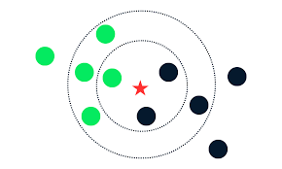
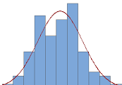
RAC: policies
-
-
-
-
-
-
-
-
-
+
-
-
KNN
Sampling
Rarity
Notes:
Sampling: considering k closer examples, we compute the probability distribution (according to distance), then label the example by sampling from this distribution.

Slide 19
RAG: generative models
Llama3.2-3B
Mistral-7B
Llama2-13B-Chat

Slide 20
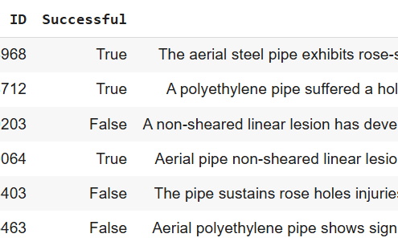
Do we need RAG?
Zero-Shot
Fixed-Examples

Slide 21
Evaluation
Notes:
SBERT and SRoBERTa are both optimized specifically for semantic similarity tasks.
Our goal was to evaluate which model performs better in retrieving relevant ids, also the labels at different cutoff points.
So now we will see at first for retrieving the relevant doc/ids as a task for both models side-by-side

Slide 22
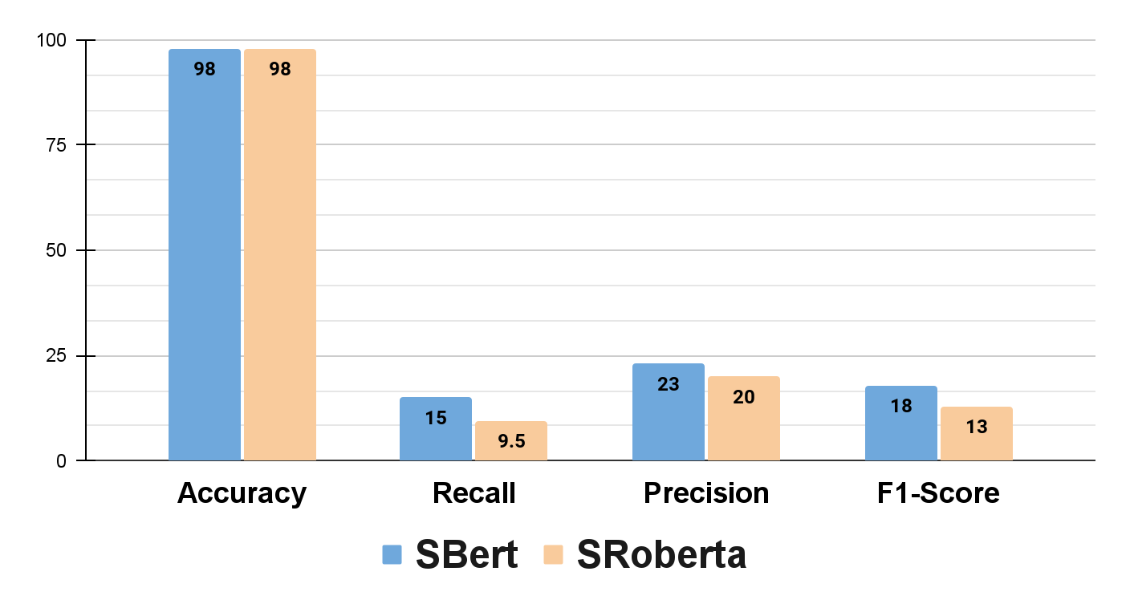
SBERT vs. SRoBERTa
Setup 1 : Half-Half Split
Comparative metrics Graph for Classification of Labels
Notes:
In the Balanced Split, both models demonstrated high Accuracy,
yet their Precision, Recall, and F1 Scores were comparatively low,
indicating a possible trade-off between correctly identifying all relevant instances and avoiding false positives.
For the Balanced Split, the F1 Scores were relatively low, with SBERT slightly outperforming SRoBERTa.

Slide 23
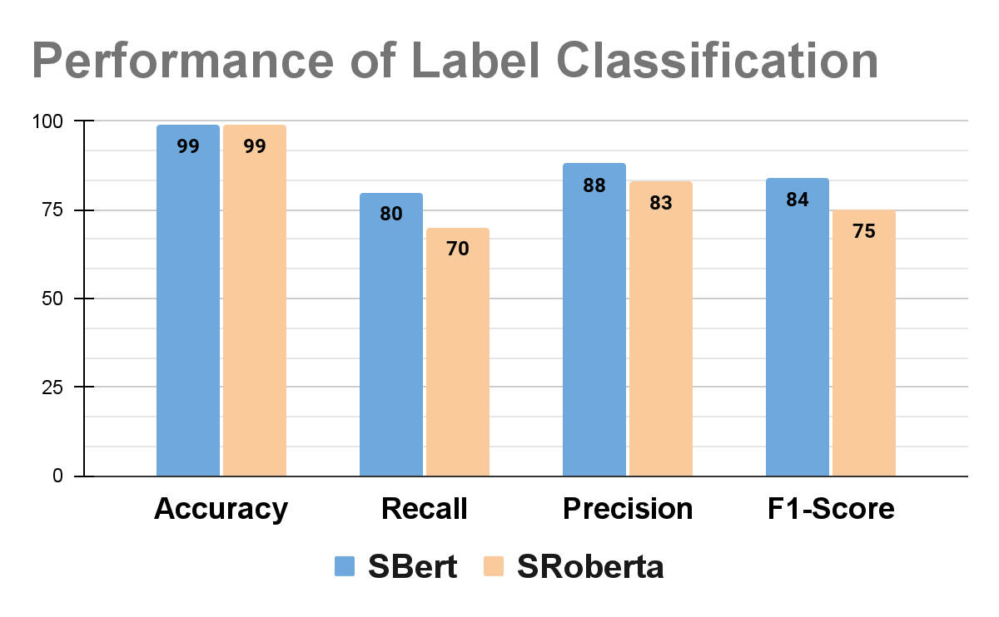
SBERT vs. SRoBERTa
Setup 2 : Rephrased Split
Comparative metrics Graph for Classification of Labels
Notes:
In the Dedicated Split, however, both models showed significant improvement in all metrics, especially in Recall and Precision, which contributed to higher F1 Scores.
This suggests that model performance substantially benefits from more targeted data handling."
SRoBERTa showed marked improvements, particularly in Recall and F1 Score, illustrating its robustness in more finely-tuned setups
To conclude here, overall dependencies are on nature of the dataset. These insights are crucial for optimizing our approaches in label classification tasks."

Slide 24
Test Set Distribution
False
(5889)
True (63)
Original Distribution

Slide 25
Test Set Distribution
False
(63)
True (63)
Downsampled Distribution

Slide 26
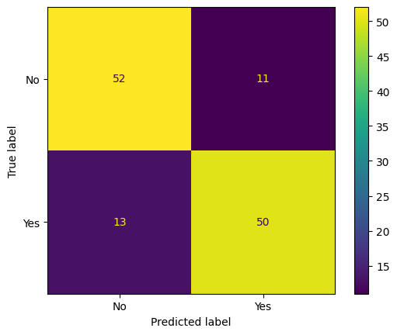
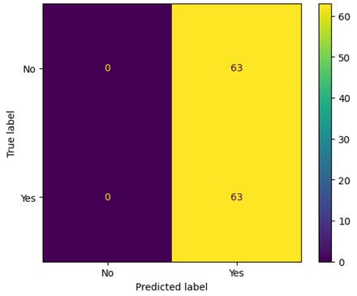
Zero-Shot
LLaMa3.2-3B seems to understand the concern even without examples.
Llama3.2-3B
Llama2-13B-Chat

Slide 27
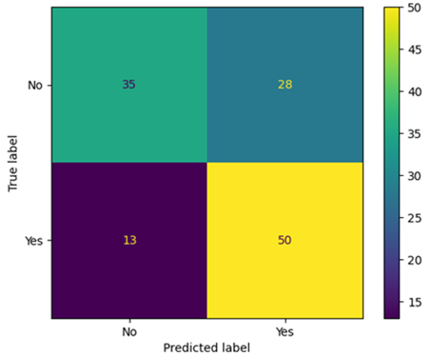
Zero-Shot vs Few-Shot Fixed-Examples
LLaMa3.2-3B seems confused by examples.
Zero-Shot
Few-Shot (FE)

Slide 28
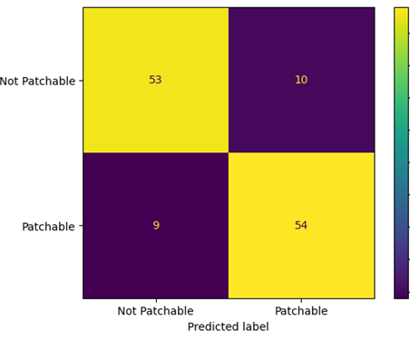
Few-Shot: label names effect
Changing label names seemed to help the model to get back on track.
Patchable/Not
Yes/No

Slide 29
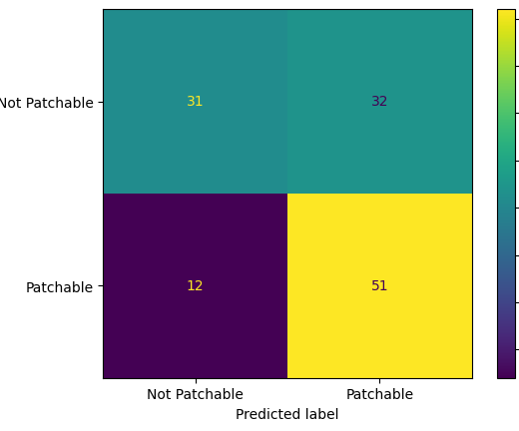
Few-Shot: Fixed-Examples vs RAG (LLama3.2-3B)
Behaviour observed regardless label names and k (here, k= 6).
Fixed-Examples
RAG

Slide 30
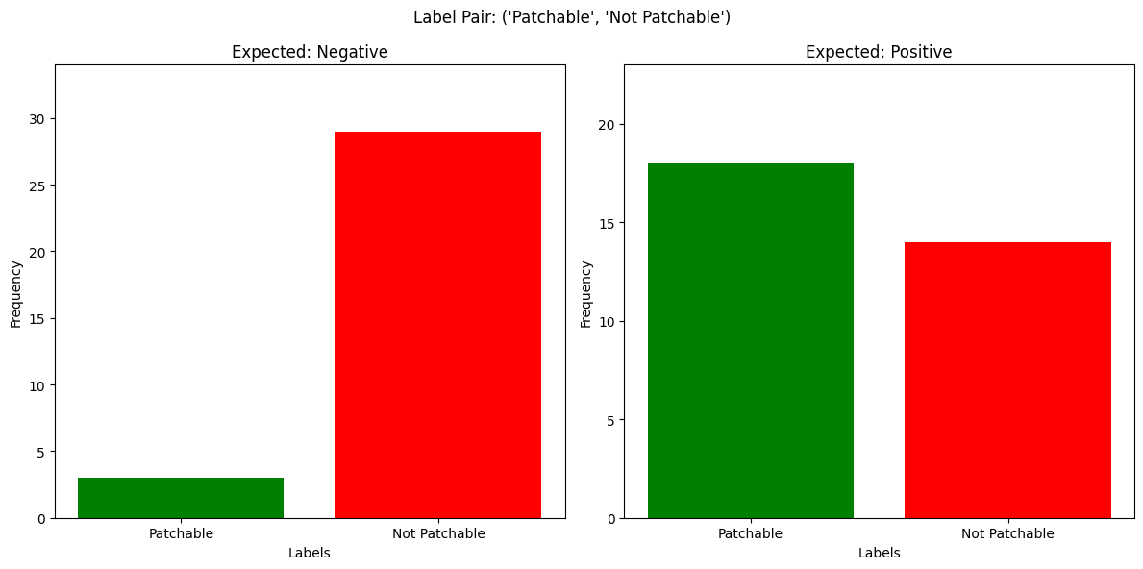
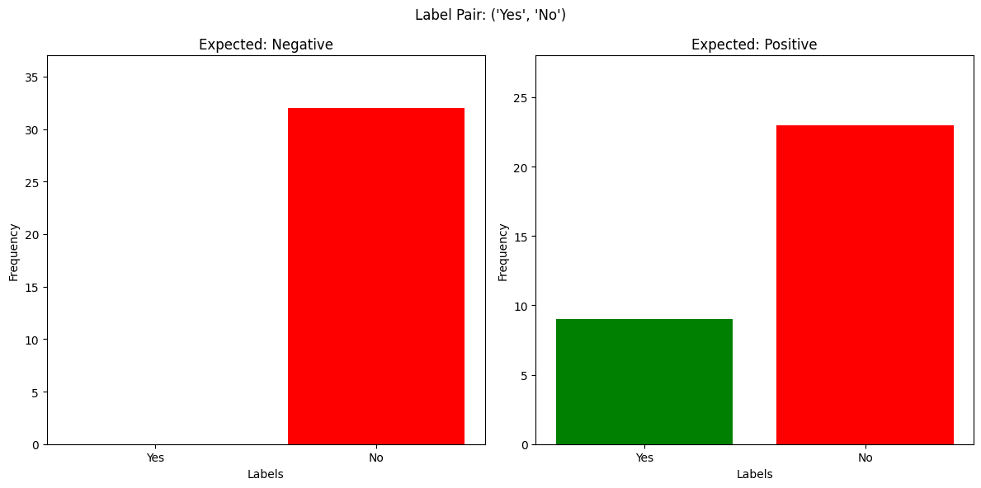
Prompt Sensitivity
Llama3.2-3B is asked to label the same example 32 times. This behaviour is not observed in other models. Results in zero-shot setting.
Yes/No
Patchable/Not

Slide 31
LLaMa3.2-3B Considerations
The model seems understand the task without examples;
Examples confuse the model;
Models’ answers are too chaotic.
The reason of chaos may lie in its small size.
The larger Llama3.2 version cannot be tested on Colab (70B)
Llama3.2-3B

Slide 32
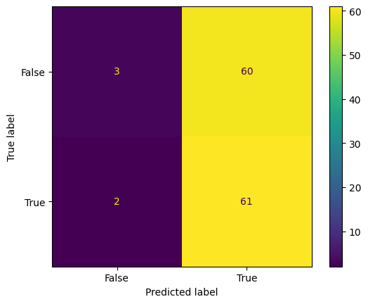
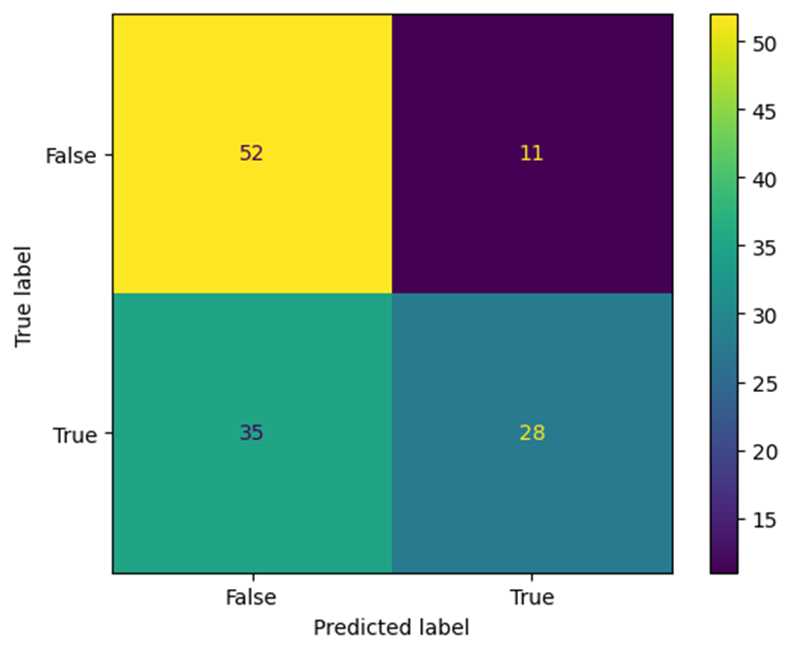
Few-Shot: Fixed-Examples vs RAG (LLaMa2-13B-Chat)
The rarity of positive skews models answer towards negative predictions (k=3).
Fixed-Examples
RAG

Slide 33
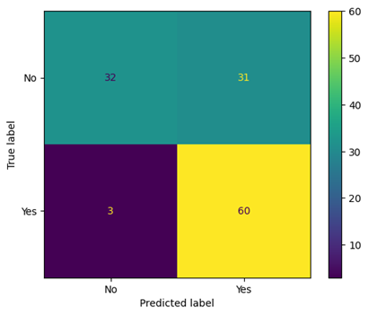
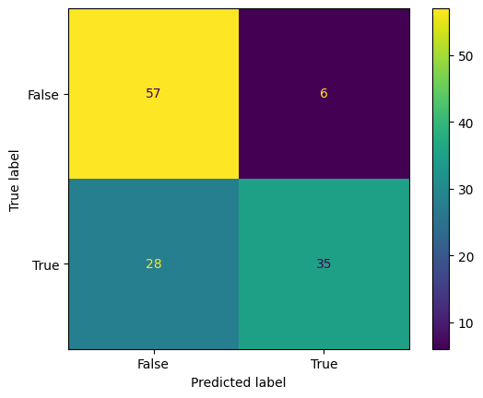
Few-Shot: Fixed-Examples vs RAG (Mistral-7B)
The rarity of positive skews models answer towards negative predictions (k=3).
Fixed-Examples
RAG

Slide 34
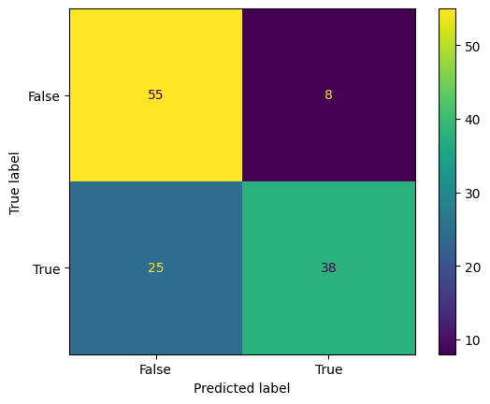
Few-Shot: Split vs Joint Examples (Mistral 7B)
Retrieving k-positive closer examples and k-negative closer examples does not help either (joint_k=6, split_k=3).
Split
Joint

Slide 35
Larger Models: considerations
Answer stability goes with model size
RAG helps the model in labelling
The scarcity of positive examples may affect performances (high FN).
Larger Models

Slide 36
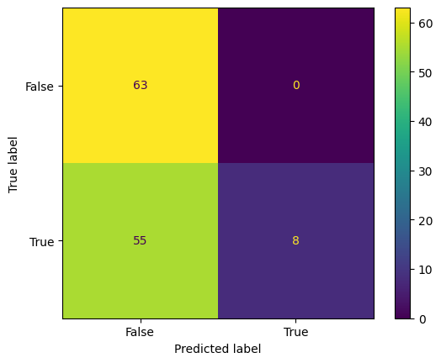
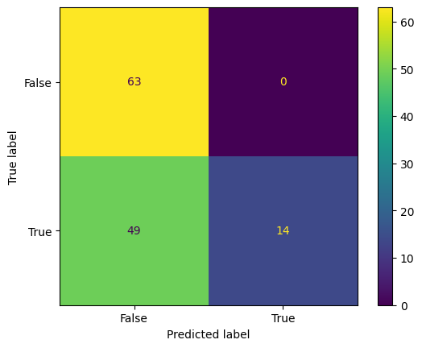
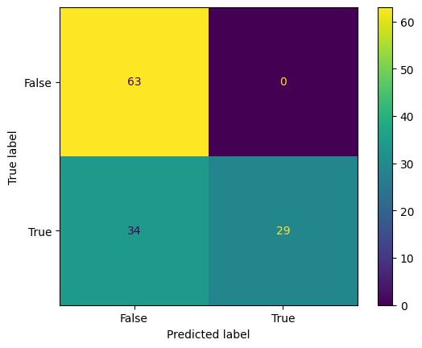
RAC: results
RAC enforces our intuition: the problem is with the scarcity of (+) reparations.
KNN
Sampling
Rarity

Slide 37
SBERT vs. SRoBERTa Across Setups
Retrieval of IDs Performance in rephrased: SBERT vs. SRoBERTa
Recall@k computation=
Number of recommended relevant items among top k
Number of all relevant items in the system
Model | Recall@1 | Recall@3
SBERT | o.61 | 0.69
SRoBERTa | 0.77 | 0.84
Notes:
our analysis suggests that SRoBERTa offers more robust retrieval capabilities, making it a preferable choice in scenarios where finding the most relevant information quickly is essential.
A high recall ensures that the retrieval system doesn’t miss out on relevant documents.
- Understanding Recall Values: A recall of 0.84 means the retrieval system is only fetching 84% of the relevant identities. But at the same time, It’s a clear indication the other 16% information might be left out by the retrieval process. [go to the next slide]

Slide 38
Retrieval Task through SBERT vs SRoBERTa - Recall@1
Comparison- summarizing key metrics side-by-side
Metric | SBERT | SRoBERTa
True Positive (TP) | 7291 | 9108
False Negative (FN) | 4613 | 2796
Recall@1 | 61% | 77%
Notes:
False Negatives (FN): SRoBERTa had fewer missed relevant items (2796) compared to SBERT’s 4613, showing it has better coverage in retrieving relevant documents.

Slide 39
SBERT vs. SRoBERTa Across Modalities
Comparative metrics Table for Classification of Labels
Metric (in %) | M1 |  | M2
 | SBERT | SRoBERTa | SBERT | SRoBERTa
F1 score | 18 | 13 | 84 | 75
Recall | 15 | 9.5 | 80 | 70
Precision | 23 | 20 | 88 | 83
Accuracy | 98 | 98 | 99 | 99
Notes:
We have conducted tests across two distinct splits: a Balanced Split which we named M1 and the Dedicated Split, calling it M2.
Each model's performance was evaluated based on four key metrics: Accuracy, Recall, Precision, and the F1 Score
Shifting towards graphical method from this tabular. [nextslide]

Slide 40
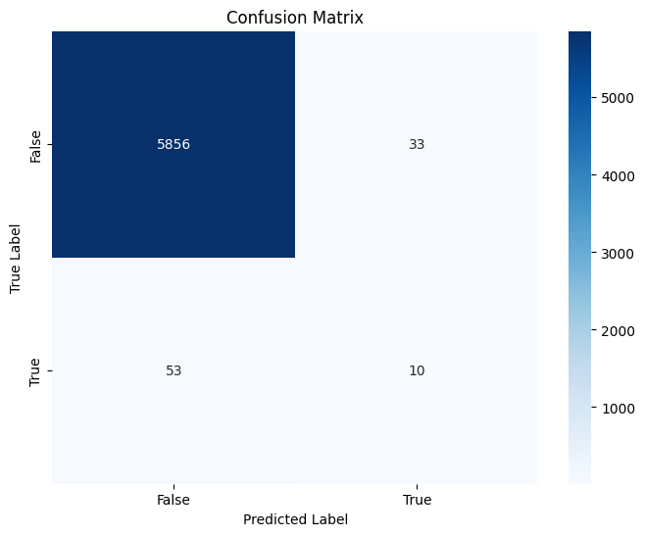
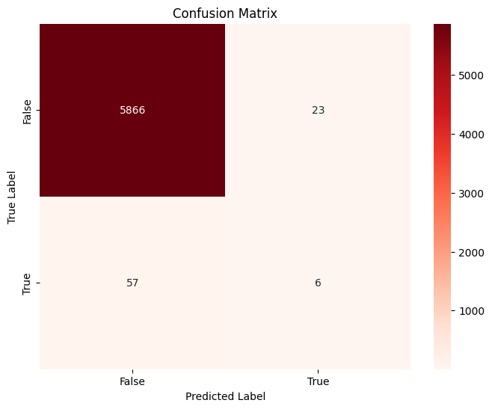
Confusion matrix comparison
Modality 1 - Balanced Split
SBERT
SRoBERTa
Notes:
The confusion matrix for SBERT shows a total of 5856 true negatives and 10 true positives
For SRoBERTa, we observed similar true negatives at 5866 but fewer false positives and false negatives, and slightly fewer true positives. This points to SRoBERTa's slightly better specificity but similar struggles with sensitivity."

Slide 41
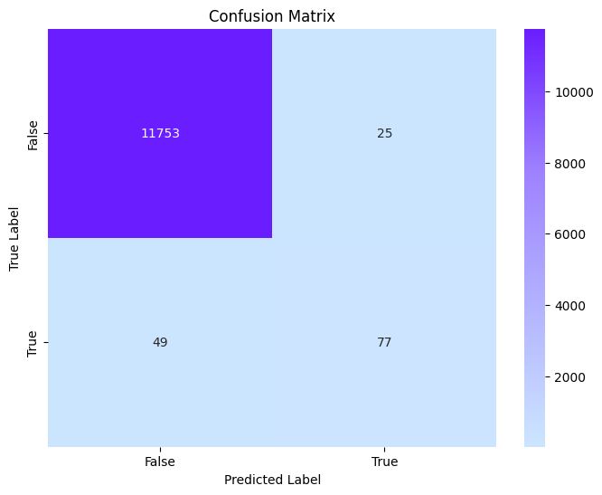
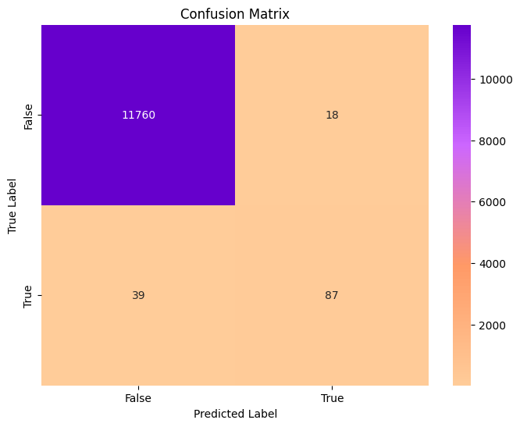
Confusion matrix comparison
Modality 2 - Dedicated Split
SBERT
SRoBERTa
Notes:
In this scenario, SBERT significantly improves, showing 11753 true negatives and 77 true positives.
SRoBERTa also shows improvement, with 11760 true negatives and 87 true positives, and even fewer false positives and false negatives than SBERT, highlighting its robustness and accuracy in more controlled conditions."
Conclusion: "In conclusion, both models perform admirably, with SRoBERTa generally outperforming SBERT in most metrics, particularly in the Dedicated Split. These findings will help guide our decision-making process for model deployment in specific applications."

Slide 42
What’s next?

Slide 43
Synthetic Data
Following our intuition about the missing-successful concern, we aim to populate RAG-DB with synthetic-generated positive examples;
Very-Large-Language-Model such as GPT-4 may be help for generate new patchable descriptions;
GPT-4 should first tested on our test-set in either a zero-shot or few-shot setting. In case of success (99% accuracy), we could consider GPT-4 examples reliable then proceed with synthetic-examples

Slide 44
ChatBot: Explanation
Further than labelling the example, the chat-bot will also be asked to generate an explanation for the choice;
We do not have examples of reasoning;
GPT-4 may judge our chatbot rationale.

Slide 45
ChatBot: Language
Since CoRe and ItalGas are Italian companies, the main interaction with the chatbot may be in Italian.
We may think to mount Italian-English translators up/down stream our chatbot

Slide 46
THANK YOU!
Grazie!
ধন্যবাদ
شکریہ
Notes:
Bengalese: dhonnobaad
Urdu: shukrya

Slide 47
Extra
Notes:
SBERT and SRoBERTa are both optimized specifically for semantic similarity tasks.
Our goal was to evaluate which model performs better in retrieving relevant ids, also the labels at different cutoff points.
So now we will see at first for retrieving the relevant doc/ids as a task for both models side-by-side

Slide 48
Zero-Shot Prompt
You are a knowledgeable pipeline maintenance assistant with expertise in gas pipe repairs.
Your task is to determine if a damaged gas pipe is repairable with patches.
### Description:
{description}
Respond with “{positive_label}” if the damage can be patched, or “{negative_label}” if it cannot. Only provide the label, no explanation.
SYS
Input
SYS

Slide 49
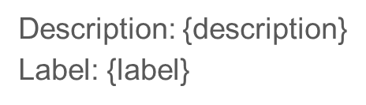
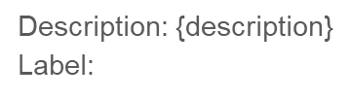
Few-Shot Prompt
You are a pipeline maintenance assistant specializing in gas pipe repairs.
Your task is to decide if a damaged gas pipe can be repaired with patches.
Here some examples:
{examples}
Basing your decision on the provided examples, complete by answering either:
- {positive_label} if the damage can be repaired by using patches;
- {negative_label} if the damage cannot be repaired by using patches.
Answer only and solely the label, do not write other words.
Query:
{query}
SYS
RAG/Fixed
SYS
Input

Slide 50
Query and Examples Format
Examples:
Description: {description}
Label: {label}
Query:
Description: {description}
Label:

Slide 51
Model Input Example
You are a knowledgable pipeline maintenance assistant specializing in gas pipe repairs.
Your task is to decide if a damaged gas pipe can be repaired with patches.
Here some examples:
Description: The aerial steel pipe exhibits rose-shaped holes in its surface, indicating a faulty section. No high pressure is present within the pipe, and there are no signs of strong corrosion or bad conditions. Additionally, there is no branch near the break, and the pipe is not covered by a wall. There are no ribs present either. This suggests that the damage is localized to this particular area, with no broader systemic issues.
Label: Yes
[…] x (top_k – 1)
Basing your decision on the provided examples, complete by answering either:
- Yes if the damage can be repaired by using patches;
- No if the damage cannot be repaired by using patches.
Answer only and solely the label, do not write other words.
Query:
Description: Aerial pipe non-sheared linear lesion detected at Bad Conditions with Steel material.
Label:

Slide 52
Prompt Sensitivity
‘Successful’ = False:
The aerial steel pipe has a non-sheared linear lesion caused by strong corrosion, despite high pressure within the pipe. The injury is located near a branch and is covered by a wall, with the presence of a valve close to the break. The pipe also features ribs, indicating that it may be more susceptible to corrosion.
‘Successful’ = True:
Aerial pipe non-sheared linear lesion detected at Bad Conditions with Steel material.

Slide 53

Yes/No

Slide 54
Patchable/Not Patchable

Slide 55
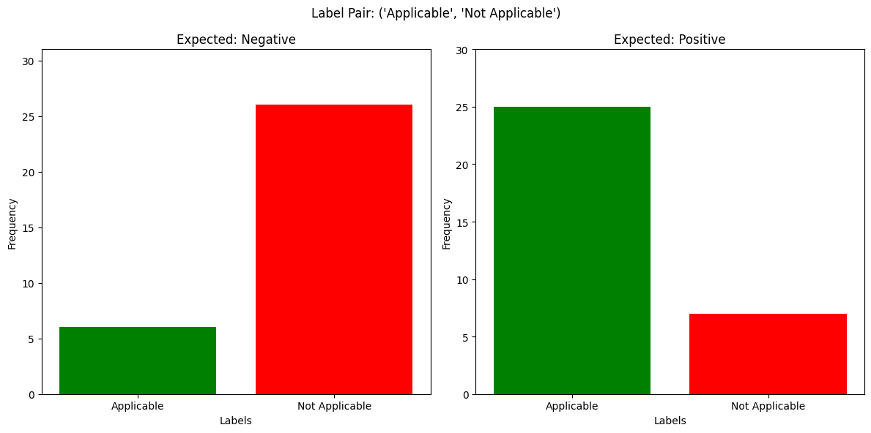
Applicable/Not Applicable

Slide 56
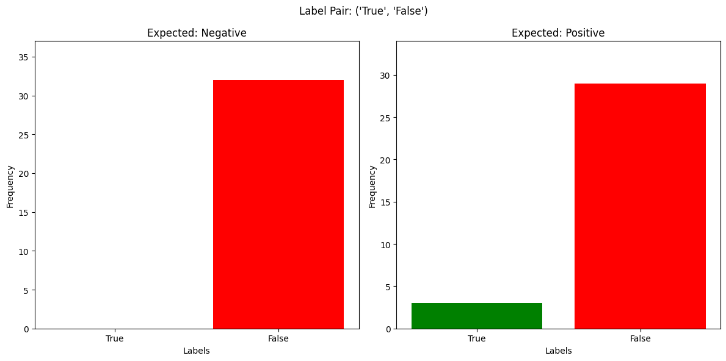
True/False

